Slide 1
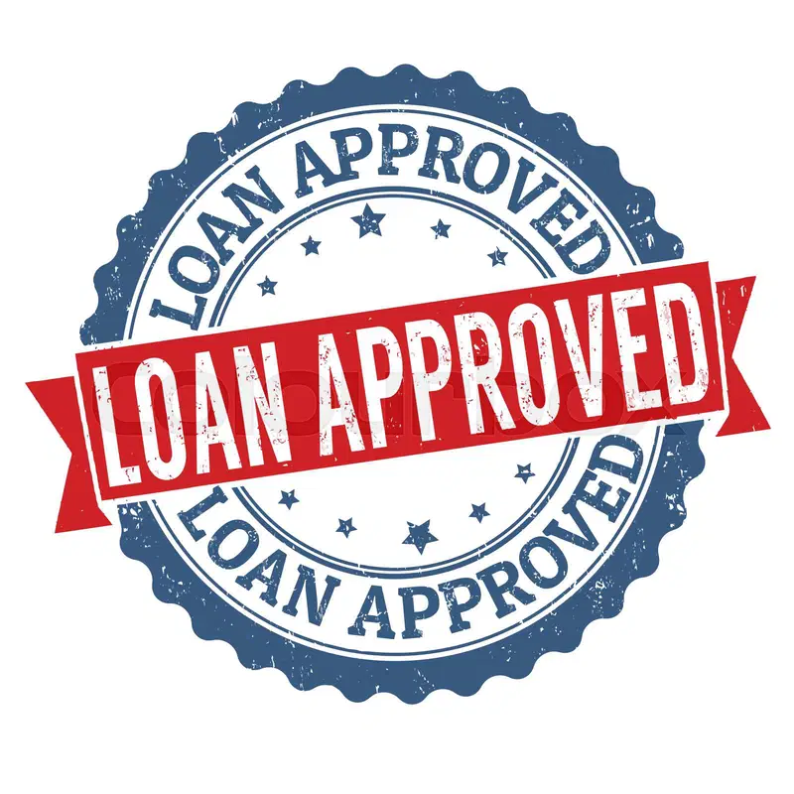
Loan Approval Prediction Using Machine Learning

Slide 2
Introduction
Loan approval is a critical decision-making process in the banking and financial sector. This project aims to predict loan approvals using machine learning by analyzing customer transaction data. The project involves data preprocessing, exploratory data analysis (EDA), feature engineering, handling imbalanced data, and applying various machine learning models to achieve accurate predictions.

Slide 3
Data Collection & Understanding
The dataset consists of financial transaction records, including details such as customer age, gender, account
type, transaction amount, credit score, and loan approval status. Key attributes in the dataset include:
Transaction_ID: Unique identifier for transactions
Date: Date and time of transaction
Customer_Age: Age of the customer
Gender: Male/Female
Account_Type: Checking, Savings, Investment
Transaction_Amount: Amount of the transaction
Transaction_Type: Deposit, Withdrawal, Loan Payment, etc.
Merchant_Category: Type of business where the transaction occurred
Card_Type: Credit, Debit, Prepaid
Balance_After_Transaction: Account balance after the transaction
Fraud_Flag: Indicator of fraudulent transactions
Credit_Score: Creditworthiness of the customer
Loan_Approved: Target variable (Yes/No)
Income: Annual income of the customer

Slide 4
Data Preprocessing & Cleaning
Handling Missing Values: Missing values in the dataset were identified and treated using imputation techniques such as mean, median, or mode.
Removing Duplicates: Duplicate records were removed to maintain data integrity.
Handling Outliers: Outliers were detected using statistical methods (IQR, Z-score) and either removed or transformed.
Data Transformation: Ensured consistent data formats and encoding where necessary.

Slide 5
Exploratory Data Analysis (EDA)
Distribution of loan approvals and rejections.
Analysis of credit score impact on loan approvals.
Correlation between income, transaction amount and Etc.
Impact of fraud flags on approval decisions.
Visualization techniques: Histograms, box plots, scatter plots, correlation heatmaps.

Slide 6
Feature Engineering
Encoding Categorical Features:
One-Hot Encoding for features like Account Type, Merchant Category, and Transaction Type.
Label Encoding for the target variable (Loan Approved: Yes/No → 1/0).
Scaling Numerical Features:
StandardScaler was applied to numerical variables to normalize data.

Slide 7
Handling Class Imbalance
The dataset exhibited an imbalance in loan approval cases. To address this, SMOTE (Synthetic Minority Over-sampling Technique) was applied to generate synthetic samples for the minority class.

Slide 8
Model Building & Evaluation
Various machine learning models were implemented and evaluated using performance metrics:
Models Used:
Logistic Regression
Decision Tree
Random Forest
XGBoost
KNeighborsClassifier (KNN)
Evaluation Metrics:
Accuracy
Classification Report
Confusion Matrix

Slide 9
Model Comparison & Best Model Selection
Machine Learning Model | Accuracy
Logistic Regression Model | 71%
Random Forest Model | 76%
KNieghborsClassifier Model | 69%
Decision Tree Model | 63%
XGBoost Model | 75%

Slide 10
Conclusion & Future Improvements
Successfully predicted loan approvals using various ML models, with Random Forest Classifier being the most effective.
Addressed data quality issues through cleaning, feature engineering and balancing.
Future improvements:
Hyperparameter tuning for further optimization.
Incorporating additional features like employment history and spending patterns.
Deployment of the model into a real-time loan approval system.

Slide 11
References
Libraries Used: Pandas, NumPy, Matplotlib, Seaborn, Scikit-learn, XGBoost, SMOTE

